Slide 1


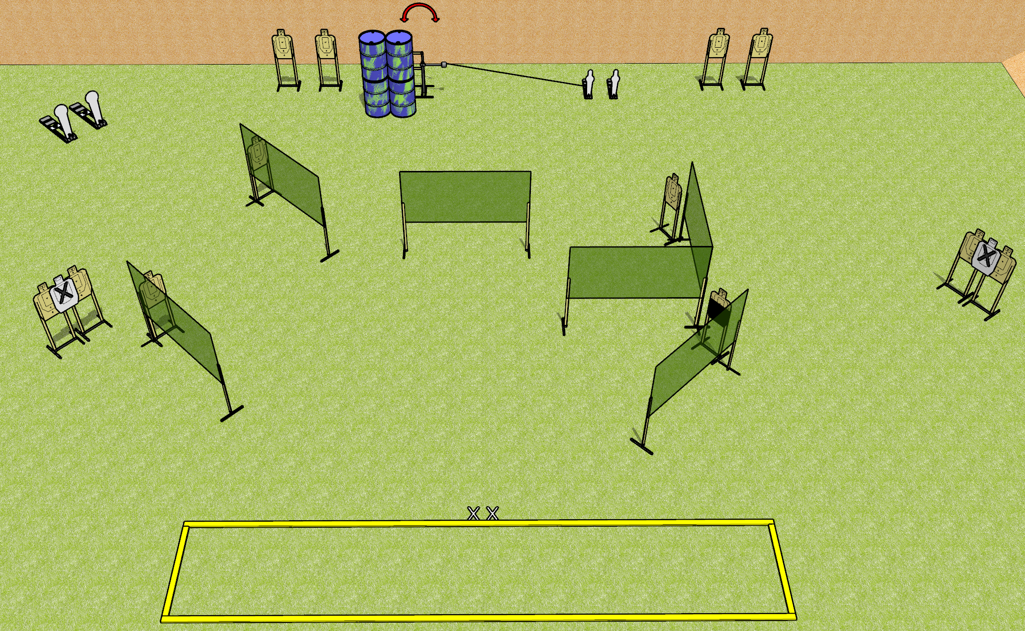
 | Dothan Gun Club – USPSA Match On Stage Course Designer : Drew Coleman
Round Count 30 rounds 13 USPSA 2 colt, 2 mini
Equipment List 11 wall feet Swinger + Activator Shooting area is 30’ wide 1 50%, 14 targets (12 + 2NS)

Slide 2
On Stage
Written Stage Briefing
Scoring: Comstock
Targets: 13 USPSA, 4 steel
Rounds: 30
Handgun start position: feet on X’s, facing down range, wrists below belt. Handgun is loaded and holstered.
PCC start position: feet on X’s, facing down range, stock on belt. Carbine is loaded, safety on.
Stage Procedure: on the audible start signal, engage targets as they become available from within the shooting area. The swinger is activated by P3 and remains visible at rest.

